Slide 1

Modern Control Theory
Lecture No. 19
Understanding the KF Estimates, Residues & Processes within the Filter

Slide 2

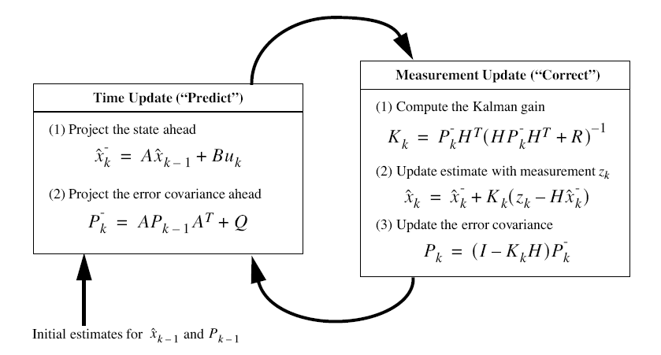


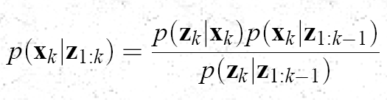
The Kalman Filter

Slide 3


Understanding the Prediction & Update Process/ Steps
Update
Prediction
(k-1)+
(k)-
(k)+
k-1
z(k-1)
k
z(k)

Slide 4
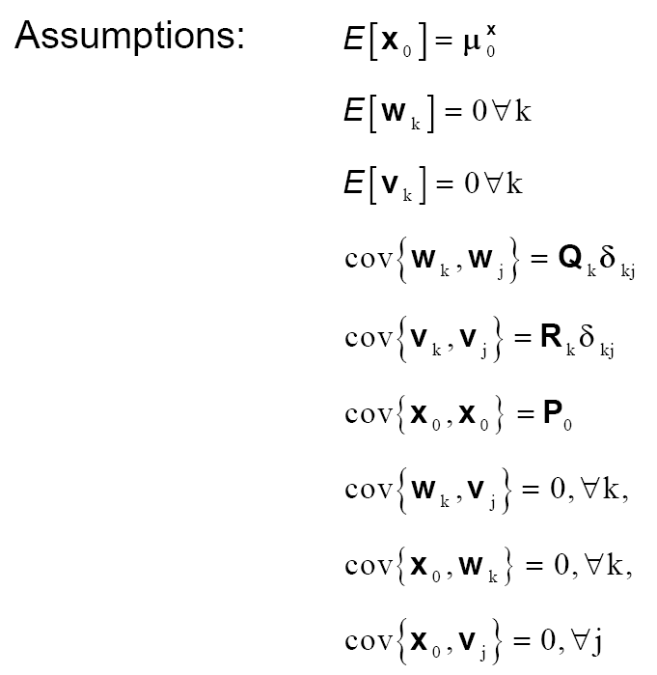


Slide 5


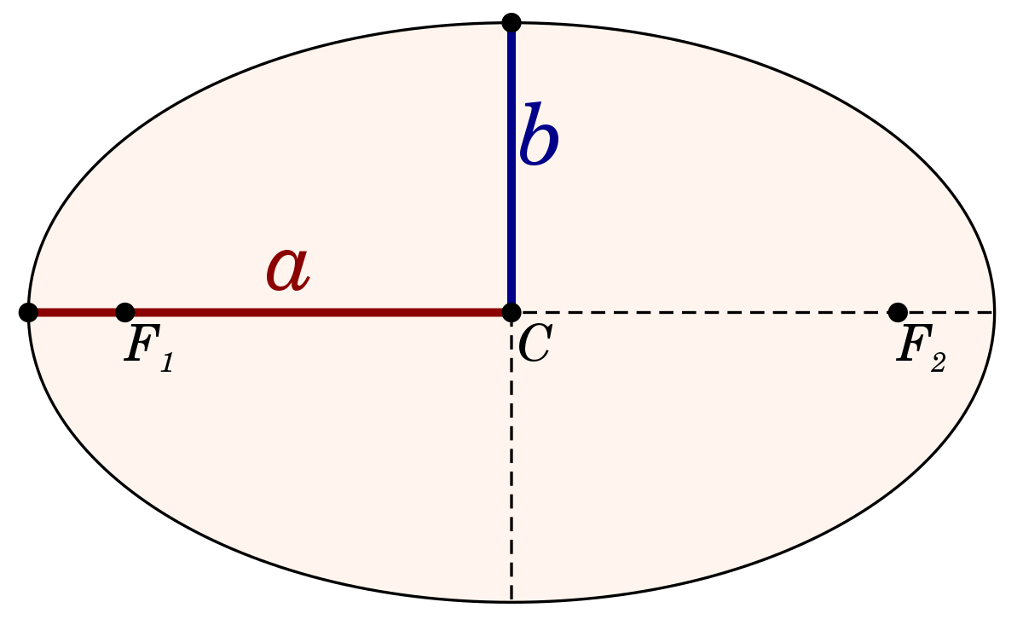
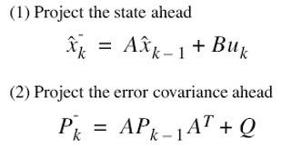




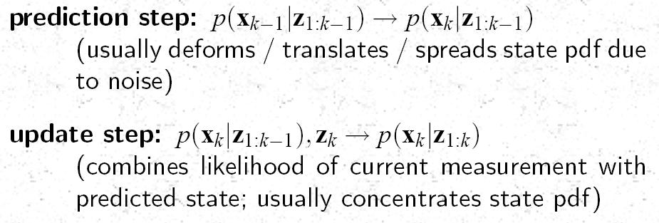
Review ---Kalman Filter --- The Bayesian Behavior
update step
(k-1)+
(k)-
(k)+
prediction step
k-1
k
z(k-1)
z(k)

Slide 6
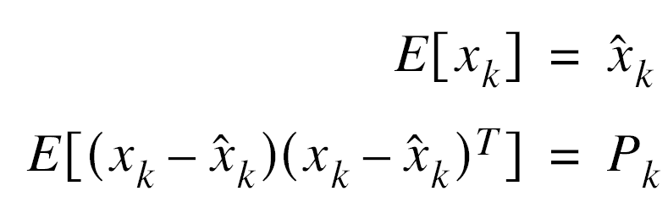
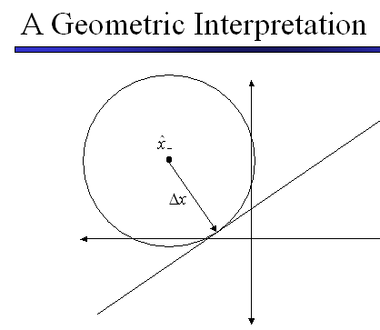
An Optimal State Estimator
Estimating State
Minimizes Error
Obtaining Mean & Covariance

Slide 7


Statistics of Processes within the Filter Structure
Error committed by using as an estimator of

Slide 8
The State Estimation Problem
Unknown Plant
I/P
O/P
State Estimator
(Plant-Model Mismatch,
Process & Measurement
Noise)
Optimal Filtering
Problem in the
Bayesian Framework
If State Equations
Non-Linear, Posterior Density
Non-Gaussian,
Closed form Optimal
Soln. not there
If
State Equations Linear,
Posterior Density Gaussian,
Kalman Filter Optimal

Slide 9
A Perspective of Modern Controls
Plant/ System
Models
Parameter/
State
Estimation
Diagnosis
Prognosis
Information
Integration
Use the States for Control of the Plant
Plant-wide Diagnosis, Prognosis, Performance Validation
Decision &
Planning

Slide 10
Bayesian Filtering : A Road Map State Estimation
Type | Model Type | Type of Noise
Kalman Filter | Linear | Gaussian
Extended Kalman Filter | Non-linear | Gaussian
Unscented Kalman Filter | Non-linear | Gaussian
Particle Filter | Non-linear | Non-Gaussian
Unscented Particle Filter | Non-linear | Non-Gaussian

